Slide 1
FBLA OHS
Ryan Biswas

Slide 2
Introduction and Trivia
Ryan Biswas (11th) from Oakton HS, Vienna, VA.
Learned programming on my own since 5th grade
Started with Visual Basic then Java, Python, C# (some C++)
Did not know C# before this project.
Written with Visual Studio Express 2013
150+ hours total
Once worked 14 hours straight
1500+ lines of code and commentary

Slide 3
Reference
I started out this project with very little knowledge of C#, however the syntax of C# is very similar to Java. The major difference between C# and Java were the libraries and new functions. I was able to learn on the go thanks to these three amazing websites:
Official Microsoft API guide – main reference
Stack Overflow– specific questions
DotNetPerls – Broad Tutorials on C# concepts

Slide 4
Problem?
FBLA

Slide 5
Design and Planning
FBLA

Slide 6
Structure
FBLA
StorageInfo
Interface
Storage
generalData [ ]
specificData [ ]
costs<String>
Int totalCost
String caseID

Slide 7
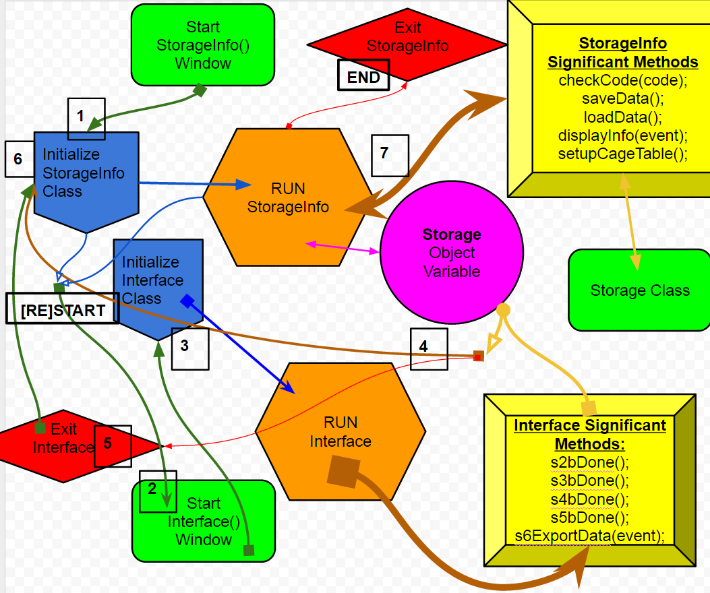
Flow

Slide 8
Key
Arrows represents the path of the program.
Arrows are colored based on its purpose and root.
Arrows that point to a block represent a call to the block’s methods
Arrows that end with a ■ represent exit/progress, the program will move to a different method(s) and won’t transverse this function again
Arrows that end with an another arrow head, ► ,resemble back and forth method calling
Arrows that have an outlined head » represents split/join where the arrow carries the function’s motives in two different directions
Arrows that have no base, represent just normal method calls
Arrows that have a circular base, • ,are functions that call multiple other functions on its way.

Slide 9
Powerful Program Features
Save and Load Data: This program can save the entire array of Storage by converting each item into a string and adding them into a .data file with special formatting. Then the program can read each line of the .data file and reconvert it back into usable data.
Statistics: The program can compute data and display the totals, averages, and most popular.
Graphs: The program can convert statistics and display it as Pie Graphs.
Help: Almost every component in the program has an associated HelpTip, which provides instructions when hovered over by the mouse
Error Management: Program checks over interaction and displays a message box to indicate error instead of crashing.

Slide 10
User Convenience Functions [U.C.F]
Small set of methods that smoothen the flow of program and ensure that data entered by the user follow the correct format. They also make the program more dynamic. They are mostly event methods, meaning that they are raised when a user interacts with the Control. So therefore they are part of the RUNTIME group and exist in both Interface and StorageInfo classes. They are effective enough to delude the user of its existence and function.

Slide 11
U.C.F List
Tab Control: When user is done with the current screen, a new tab is added based on what the user entered. This maintains a chronological flow to the program and can be back tracked to change entered information.
Reset Input: If user wants to restart the whole process, an unchanging tab at the top left corner can be clicked to clear ALL entered data and variables and reset any user interaction.
Watermark Effect: All TextBoxes and ComboBoxes display a preliminary instruction text in their input field. This text is automatically cleared when the user focuses on the input field. However if the user doesn’t enter anything the field resets back to its Watermark text.
Numeric Input: A special attribute that only allows the user to input numbers.
Progression Marker: If the watermark is removed from an input field, it changes its color to bright green to indicate progress. This attribute is checked at the end to allow the user to progress onto the next screen.
Additional Information: The fields for additional information are only revealed if the user prompts it by interacting with a field that requires it.
ComboBoxes: User can either type information into the ComboBox or select one of the preset options already available by clicking ANYWHERE on the field.

Slide 12
Instructions
This program features a large UI for easier operation. Also features a dark background to reduce eye strain, which is offset by bright neon font
This program comes in a package with the app itself, 3 C# class files, 1 .data file, and the entire C# project (open with Visual Studio 13).
To get started unzip all the contents into ‘C:\NLCDesktop\’
RUN: Open ‘Ryan Biswas FBLA.exe’
The appData.data file contains some previously entered data to
VIEW: To view the code and design of program open Visual Studio 2013 > Open Project > Open ‘Desktop Application Development.sln’ from C:\NLCDesktop
The main classes are StorageInfo.cs, Interface.cs, Storage.cs

Slide 13
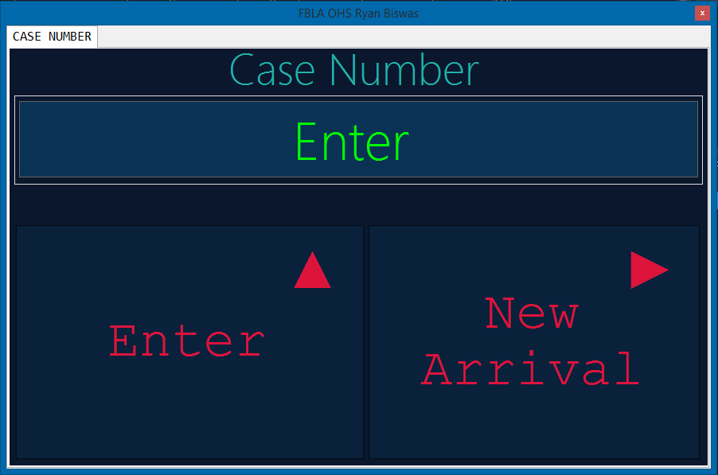
Program Progress Guide
StorageInfo()
windowOpen()
startupApp()
Interface()
Start StorageInfo()
The Program is first started by calling the main window/class, StorageInfo().
StorageInfo() calls two initializer methods, windowOpen() and then startupApp().
These two methods create the structure for the Program and then progresses the program to allow user interaction by calling the first instance of Interface().

Slide 14
Program Progress Guide
Interface()
interfaceLoad()
startupApp()
Interface
RUNTIME
methods
Start Interface()
The instance of Interface class initializes itself by calling its interfaceLoad() and then its startupApp()
interfaceLoad() and startupApp() work with each other to setup variables and execute some functions.
interfaceLoad() and startupApp() starts and ensures that the RUNTIME methods for Interface class run smoothly without error.

Slide 15
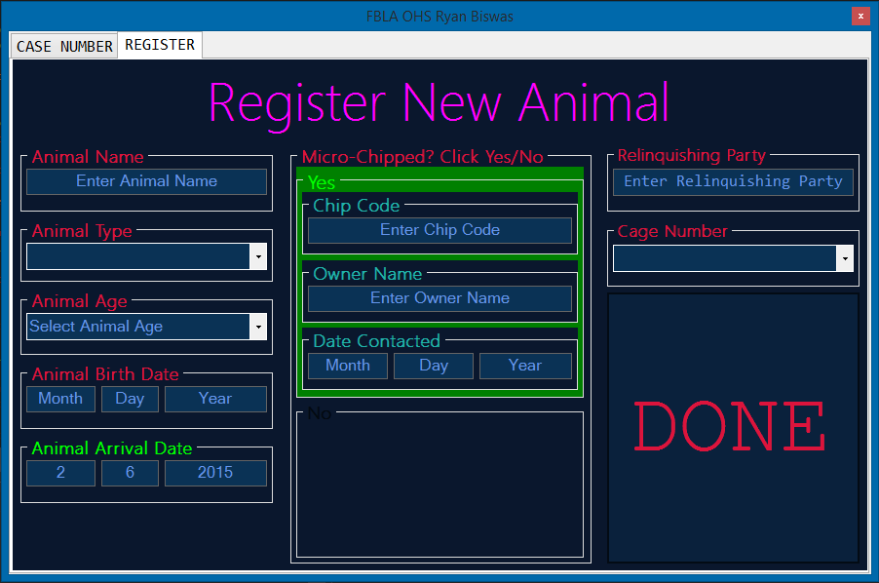
Program Progress Guide
Interface
RUNTIME
methods
Interface
Main Methods
Storage
Object
Variable
Run Interface()
The user then progress through two sets of screens [Register New Animal] > [More info]
These screens are handled by RUNTIME methods
The data from these screens are compiled and managed by the Main Interface methods
The final compiled data is then used to create a Storage object variable that is added an array of Storage variables. [represents cages in shelter]

Slide 16
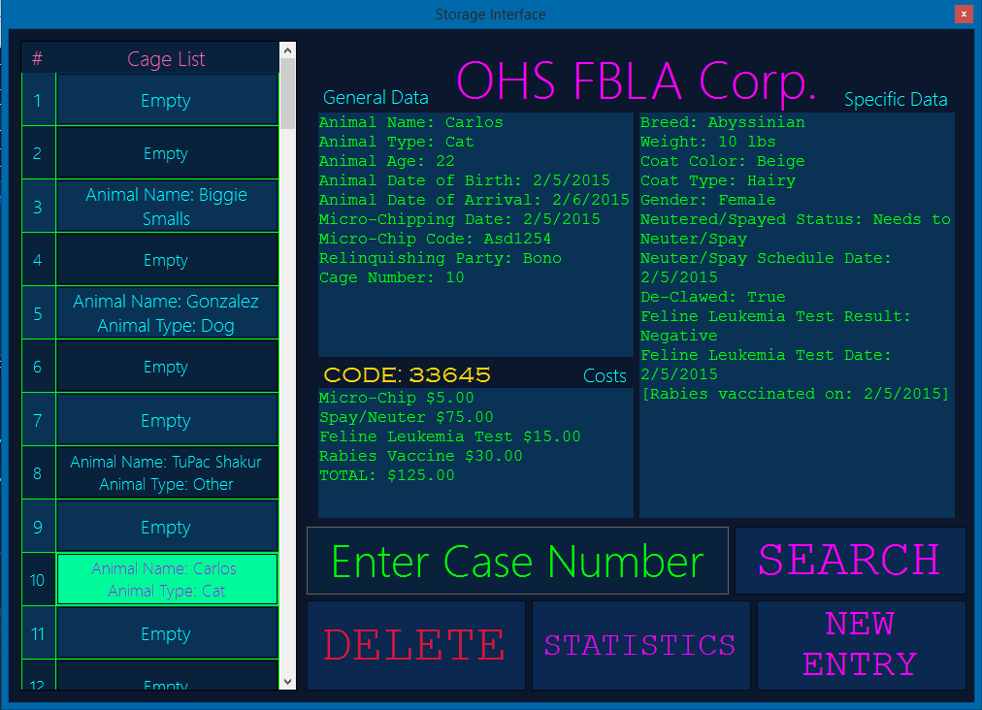
Program Progress Guide
Interface
Exit
StorageInfo
RUNTIME
methods
StorageInfo
Main Methods
Storage[]
Object
Variables
Run StorageInfo()
Once StorageInfo() has been restored, it allows for user interaction with data.
The user can view ALL entered data about the selected animal
The user then has an option to view that animals data as pie charts comparing it to the shelter average
The user can also view the shelter’s statistics
The user can also search up, delete or add more data via Interface() window

